Slide 1
OCA to OpenC2 Mapping

Slide 2
OCA to OpenC2 – C4 Diagram
OCA Action | OpenC2 Mapping (Action/Target)
Quarantine | Contain File, Contain device
Block File | Deny Process, Deny File
Block URL | Deny URL
Query Device | Query Device
Open Incident Response Case | SIEM or Threat Intelligence to SOAR

Slide 3
OCA to OpenC2 – Use Case Mappings
OCA Action | OpenC2 Mapping
Endpoint Protection Software (EPSW) – update signatures | Update File
EPSW checks for new network blocks | Query Files
EPSW scans file | Scan Files
EPSW sends alert to logging tools
EPSW receives Quarantine file request | Contain File
EPSW polls TIP for updated malicious hash list | Update File

Slide 4
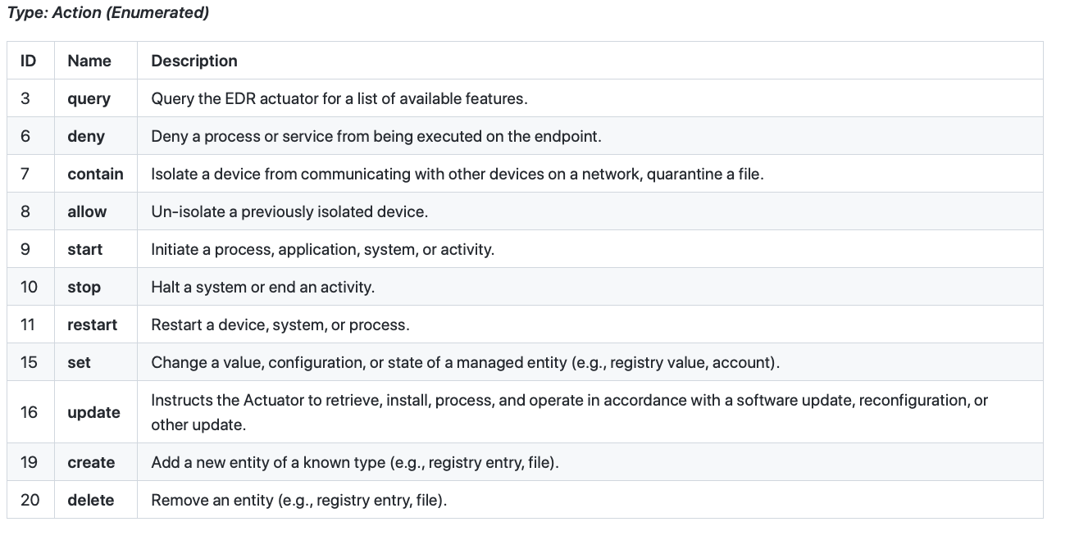
OpenC2 EDR Actuator Profile

Slide 5
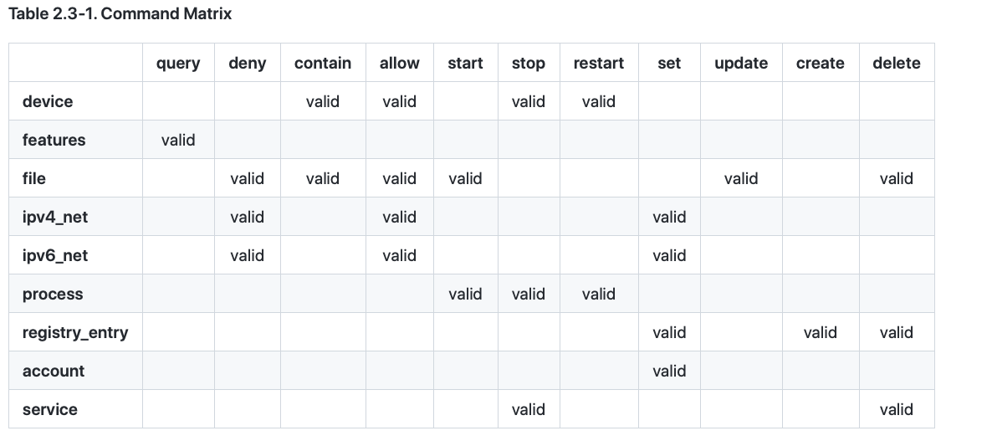
EDR Command/Target Matrix
OCA
Missing:
Query Device
Block URL
Scan Files

Slide 6
OCA to OpenC2 – Use Case Mappings
OCA Action | OpenC2 Mapping
TIP gathers updates (threats) | QUERY or REST API
Email filtering deny list update (threats) | DENY
New blocking policy pushed out by operations | Update
Security operations invokes new server scan | SCAN
Vulnerability service scans new server VM | SCAN

Slide 7
OCA to OpenC2 – C4 Diagram - PACE
OCA Action | OpenC2 Mapping (Action/Target)
Publish Collection Results | (Endpoint, Malware protect for Email, Malware protect for Endpoint to Posture Collection)
Perform Posture Attribute Collection | Query (Posture Collection System to Endpoint, Malware protect for Email, Malware protect for Endpoint)
Orchestrate Posture Assessment | SOAR to Posture Collection System
Orchestrate Posture Collection | Query (posture attributes) SOAR to Posture Assessment System
Assess Endpoint Posture | Query (SIEM or SOAR to Posture Collection System)
Collect Posture Attributes Action | Query (SIEM or SOAR to Posture Collection System)

Slide 8
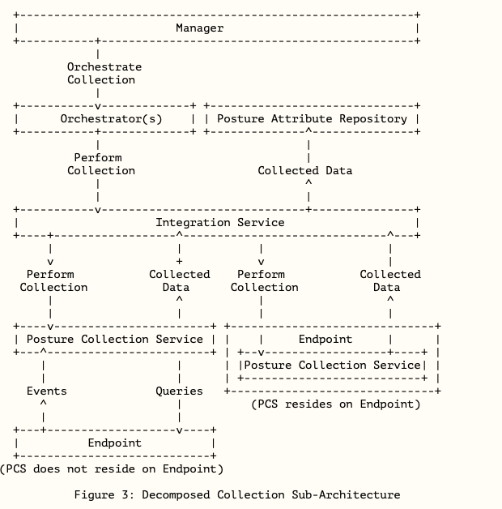
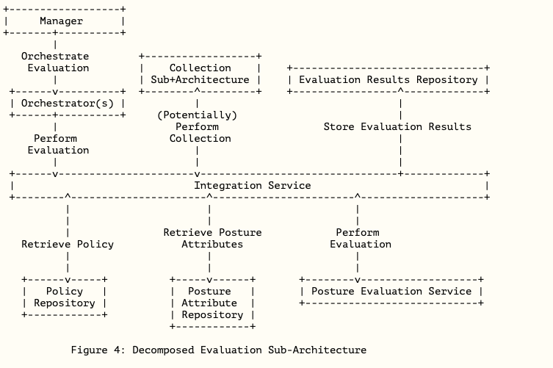
SACM Architecture

